Slide 1
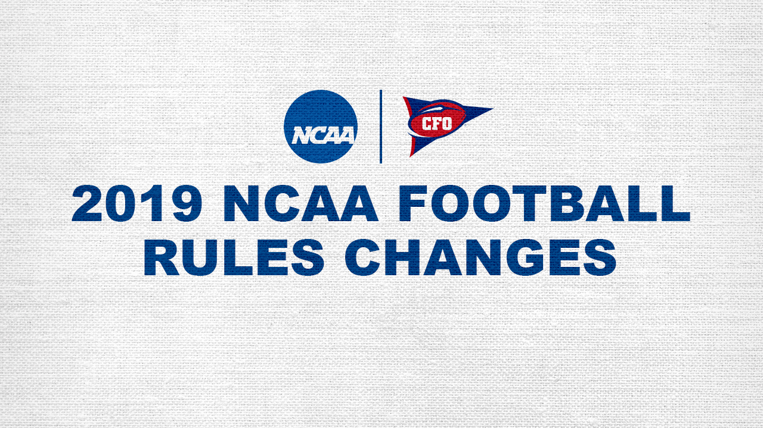

Slide 2

RULE CHANGE PROCESS
Two-Year Rules Change Cycle
2019 Is an OFF Year – Changes only considered for Player Health and Safety, a rule change from the previous season that is not achieving its intent or changes that have a significant impact on the image of the game.
Commissioner, Coordinator, AFCA, and Competition Committee Input.
Rules Committee action on March 1st, with PROP approval on April 22nd.

Slide 3
Targeting – Instant Replay Review
(Rule 12-3-5)
For a player to be disqualified and the Targeting foul enforced, all elements of a Targeting foul must be confirmed by the Instant Replay Official.
If any element of Targeting cannot be confirmed, then the Replay Official shall overturn the targeting foul.
There is now no option for stands as a part of a Targeting review.

Slide 4
Targeting Elements
(Rule 9-1-3 & 9-1-4)
Targeting elements include:
Rule 9-1-3:
  (a) A player takes aim at an opponent for the purposes of attacking with forcible contact with the crown of the helmet.
  (b) An indicator of targeting is present.
Rule 9-1-4:
  (a) A defenseless opponent (Rule 2-27-14)
  (b) A player takes aim at a defenseless opponent for the purposes of attacking with forcible contact to the head or neck area.
  (c) An indicator of targeting is present.

Slide 5
Indicators of Targeting
(Rule 9-1-4, Note 1)
“Targeting” means that a player takes aim at an opponent for purposes of attacking with forcible contact that goes beyond making a legal tackle or a legal block or playing the ball.
Targeting Indicators include but are not limited to:
Launch – a player leaving his feet to attack an opponent by an upward and forward thrust of the body to make forcible contact in the head or neck area
A crouch followed by an upward and forward thrust to attack with forcible contact at the head or neck area, even though one or both feet are still on the ground
Leading with helmet, shoulder, forearm, fist, hand or elbow to attack with forcible contact at the head or neck area
Lowering the head before attacking by initiating forcible contact with the crown of the helmet

Slide 6
Targeting – Progressive Penalty
(Rule 9-1-3 & 9-1-4)
If a student-athlete receives a third or any subsequent targeting foul within the same season, that player is disqualified for the remainder of that game and the player would receive an automatic one-game suspension in his team’s next scheduled game.
For games involving Instant Replay, the review decision is final, and there is no appeal.
For games in which Instant Replay is not used, the conference has the option to consult the National Coordinator for a video review.

Slide 7
Overtime Scoring
(Rule 3-3-f)
There is no change to the first four overtime periods.
Beginning with the fifth extra period, each team will move directly to attempt a two point try.
In the absence of a media timeout, after the second and fourth extra period, there will be a two minute mandatory break period (3-3-h).

Slide 8
Free Kick – Illegal
Wedge Formation
(Rule 6-1-10)
A wedge is defined as two or more players aligned shoulder to shoulder within two yards of each other.
For a Free-kick down only: After the ball has been kicked, it is illegal for two or more members of the receiving team intentionally to form a wedge for the purpose of blocking for the ball carrier.
This is a live-ball foul, whether or not there is contact between opponents.
Formation of the wedge is not illegal when the kick is from an obvious onside kick formation.
There is no foul if the play results in a touchback, free kick out of bounds, or fair catch.

Slide 9
Blind-Side Block
(Rule 2-3-7 & 9-1-18)
A blind-side block is an open field block against an opponent that is initiated from outside the opponent’s field of vision, or otherwise in such a manner that the opponent cannot reasonably defend himself against the block. (Exceptions: (1) the runner; (2) a receiver in the act of attempting to make a catch)
No player shall deliver a blind-side block by attacking an opponent with forcible contact.
Personal Foul, 15 yard penalty (new signal XX).
In addition, if this action meets all the elements of targeting, it is a blind-side block with targeting (Rule 9-1-3 / 9-1-4).

Slide 10
Blocking Below the Waist
Team B
(Rule 9-1-6-b)
When the defense is allowed to block below the waist by rule, the block must be directed from the front. This now lines up with the offensive team’s requirement.

Slide 11
Supervision – Officiating Crews
(Rule 11-2-1-b)
2019 Change to take effect August 1, 2020
Officiating crews, including the Instant Replay Official, will be assigned from the same officiating organization.

Slide 12
Coaches’ Phones and Headsets
(Rule 1-4-12)
Total of 23 Communications Devices allowed.
15 for Countable Coaches and Graduate Assistants.
Four (4) for Squad Members or Undergraduate Student Assistants, Three (3) listen only devices in the Coaches Booth for individuals within 10 years of their graduation or playing eligibility, and one (1) on field for non-coaching activity.
Only Countable Coaches, Graduate Assistants and three (3) individuals within 10 years of their graduation or playing eligibility with listen only capability are allowed in the Coaches Booth.
Allowance for 1 communications technician on the field and 1 in the Coaches Booth.
All Coaches’ Phones, Headsets and Communications devices are not subject to playing rules penalties before or during the game.

